Slide 1
Dear Diary
Milestone I – Andreas Gruber

Slide 2
Agenda
Finished Tasks
File Structure
To-dos
Challenges
Upcoming Features

Slide 3
Finished Tasks
Register/Login/Logout
Switching between login and register
Password matching with special characters
Forward to dashboard when already signed in
Dashboard
Created logo and background images
Created and styled memory entries
Create dynamically memories from templates
Automatically put the memories in the correct sections
Clicking trough memories
Created and styled popup to enter new memories
Responsive styling
Sqlite
Created Sqlite db with tables
Sqlite connection

Slide 4

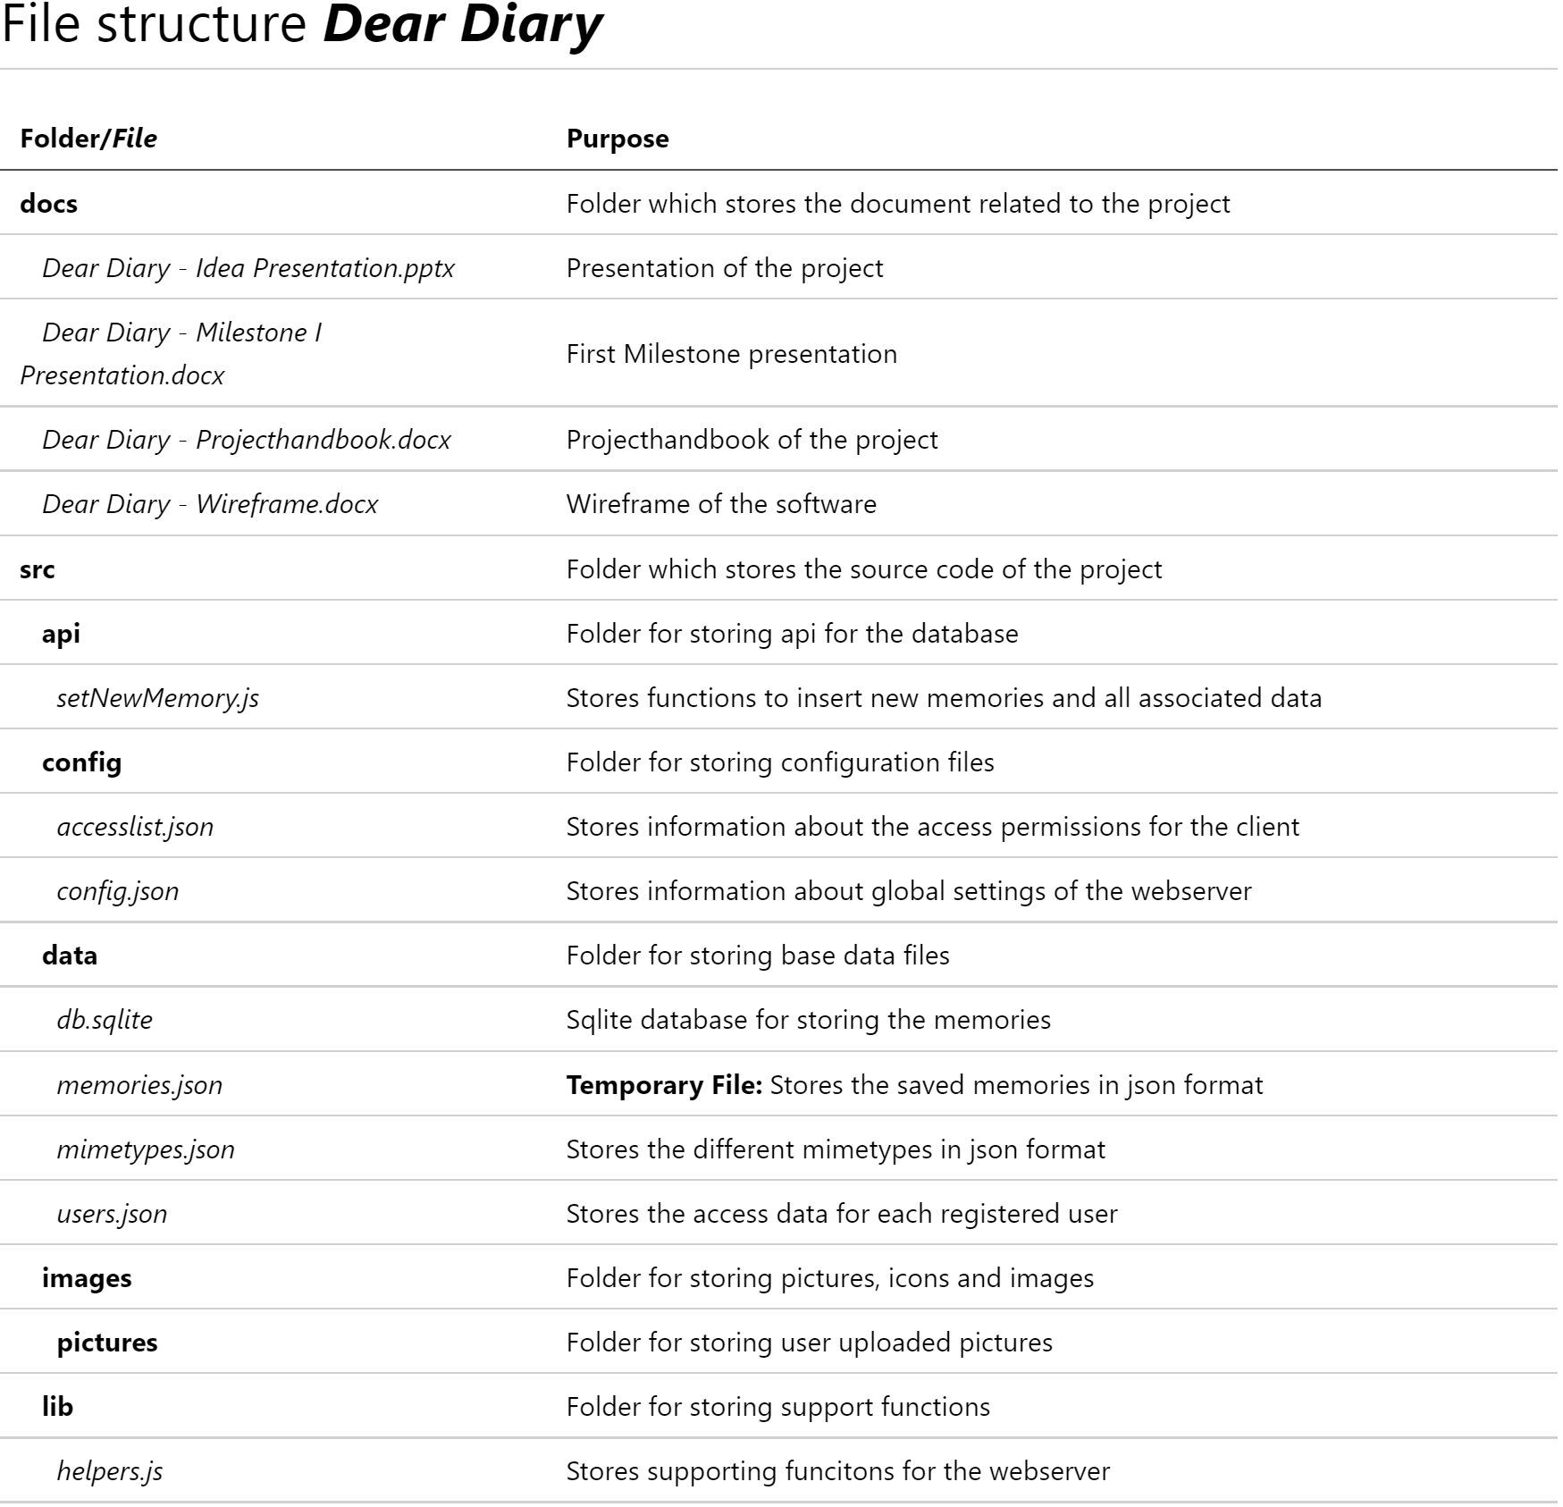
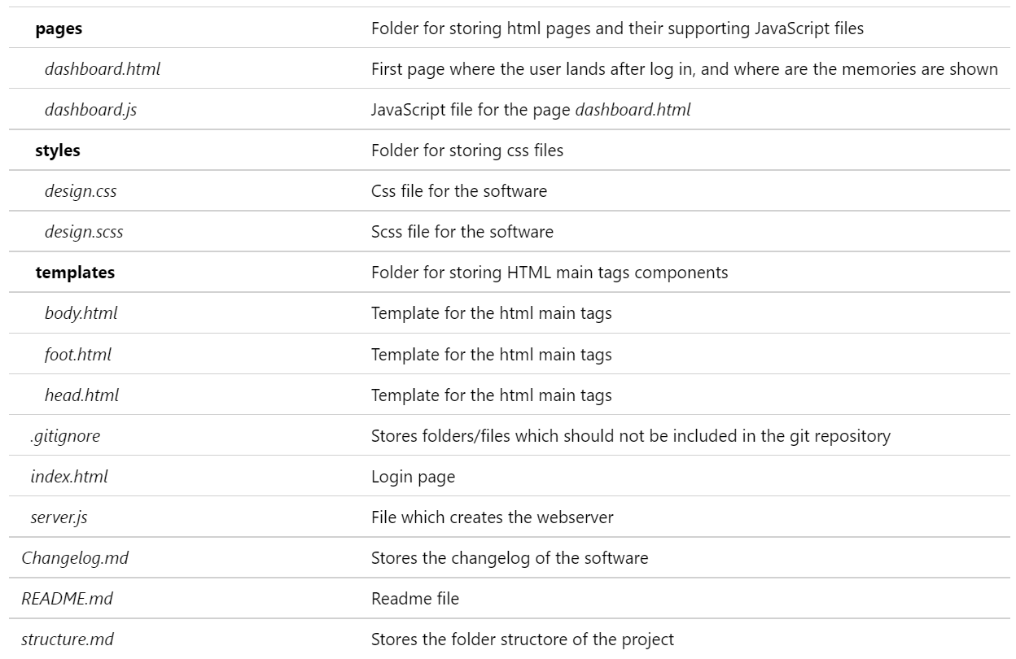
File Structure

Slide 5
To-dos
Remove Arrow (last/first element)
Image upload
Tagging (Locations, activities, persons)
Saving memories
Editing memories
Deleting memories
Filter & Search memories
Nice to have
Animate Dashboard
Google Places API

Slide 6

Challenges
Password Regex
Testing on Safari
At least 1 special char
At least 1 number
6 – 30 characters
Download version only up to version 5.xx
Virtual Safari Browser abo not for free and test version very limited
Don’t want to set up a VM

Slide 7
Upcoming features
Image upload with preview (multiple)
Article scroll-snap
Toggle arrow left/right

